Slide 1
COURSERA CAPSTONE PROJECT
THE BATTLE OF NEIGHBORHOODS (WEEK 2)

Slide 2
1. Introduction / Business Problem
A foreign restaurant company is looking for the best place to open their business in the Philippines where it requires that the location should be in the following:
high concentration of corporations for prospect customers
proximity to shopping malls or grocery stores for food supplies
established competitors as basis for human traffic in the area
First, we need to determine which region and city in the Philippines is the best location and then finally to identify which neighborhood is ideal considering above requirements.

Slide 3
Target Audience
The project also aims to target the following audience:
Businesses looking for new location to open their shops
Employees and job seekers trying to find their preferred neighborhood
Travelers searching for a place to stay where proximity to amenities is important

Slide 4
2. Data
To solve the problem as defined, the following data are required:
List of cities in the Philippines from Wikipedia to ensure all top cities in the country are considered. The Wikipedia website's table containing the list of cities will be scraped using BeautifulSoup to be stored in Pandas DataFrame.
Link: https://en.wikipedia.org/wiki/List_of_cities_in_the_Philippines

Slide 5
2. Data
The following will also be utilized to ensure that there is business demand and pricing of commodities are stable for profitability of the company:
A. Projected Population of the Philippines from 2020 to 2045 (used as basis for long term business demand)
Link: https://psa.gov.ph/sites/default/files/attachments/hsd/pressrelease/2010%20CB%20-%20Tables%20for%20Special%20Release.xlsx

Slide 6
2. Data
B. Consumer Price Index (CPI) for All Income Households by Commodity Group and Geographic Area 2012 to 2018 – Philippines (used to gauge and ensure stability of pricing and expenses)
Link: http://openstat.psa.gov.ph/sites/default/files/CPI_2012%3D100_2012-2018_v_1.xlsx

Slide 7
2. Data
Foursquare API - to be used to get the top venues of neighborhoods
Link: https://developer.foursquare.com/places-api#accountTypes

Slide 8
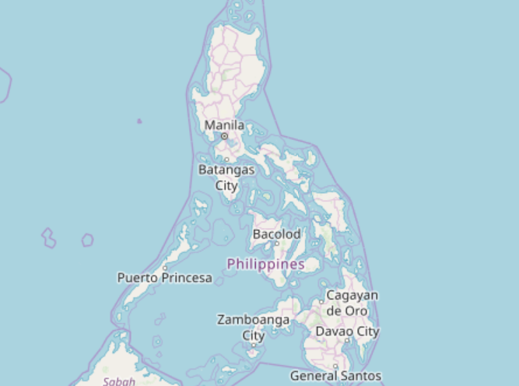
3. Methodology
Overview
The Philippines is an archipelago that comprises over 7,000 islands with a total land area of 115,831 square miles, grouped into three: Luzon (north), Visayas (center) and Mindanao (south). The country has diverse population which is spread all over cities and provinces.

Slide 9
3. Methodology
In order to achieve the objective of finding the ideal location to open a restaurant the following steps were performed:
First, to find the best city in the Philippines considering customer demands and business operational cost. Accordingly, density per city for customer demand, population projection for long term viability of the business, and consumer purchasing index (CPI) were used as basis. CPI is a statistical estimate which measures changes in the price level of market basket of consumer goods and services purchased by households.
Second, clustering the neighborhoods of the selected City using Kmeans. Kmeans is an unsupervised machine learning clustering algorithm, which can partition unlabeled data with similar characteristics to quickly discover insights.
Finally, select the best cluster of neighborhoods visually based on the cloud map of categories of venues generated from Foursquare.

Slide 10
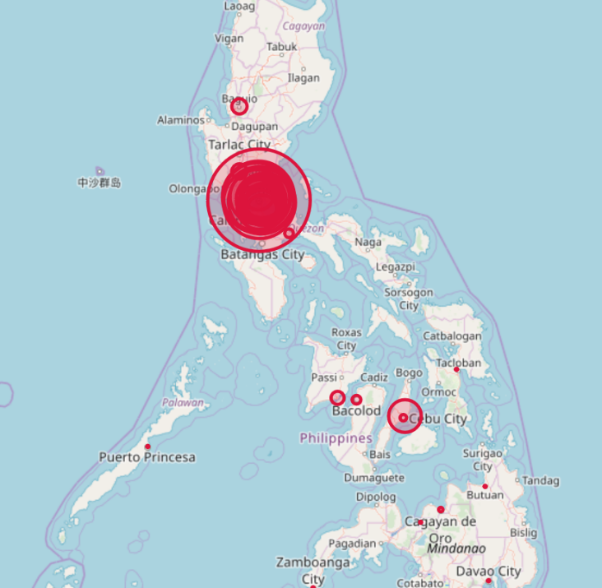
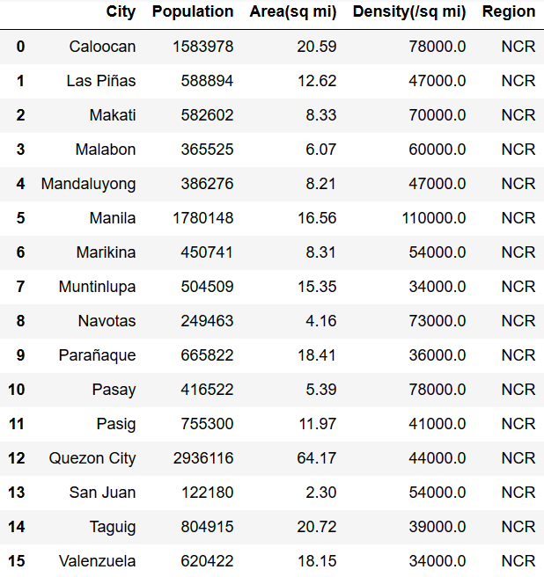
NCR Cities of the Philippines
As per Philippine Statistics Authority (https://psa.gov.ph), the National Capital Region (NCR) or commonly known as Metro Manila has a population of 12.8M in only an area of 239 square miles (620 sq km) as of 2015. This is roughly 13% of the total population in the country.

Slide 11
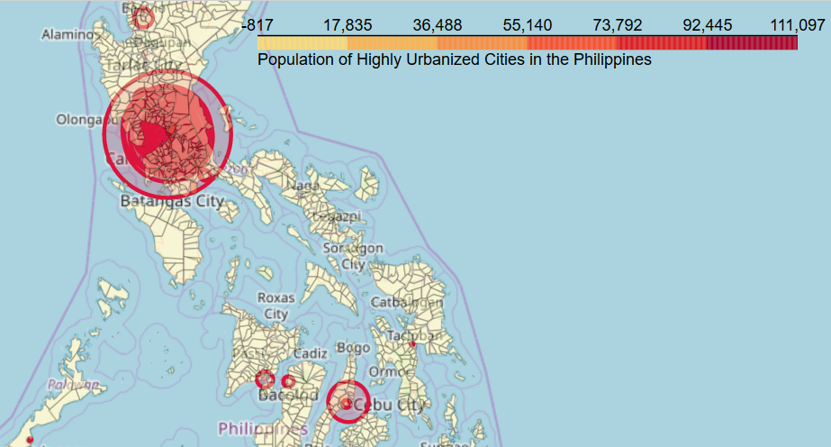
NCR (Metro Manila)

Slide 12
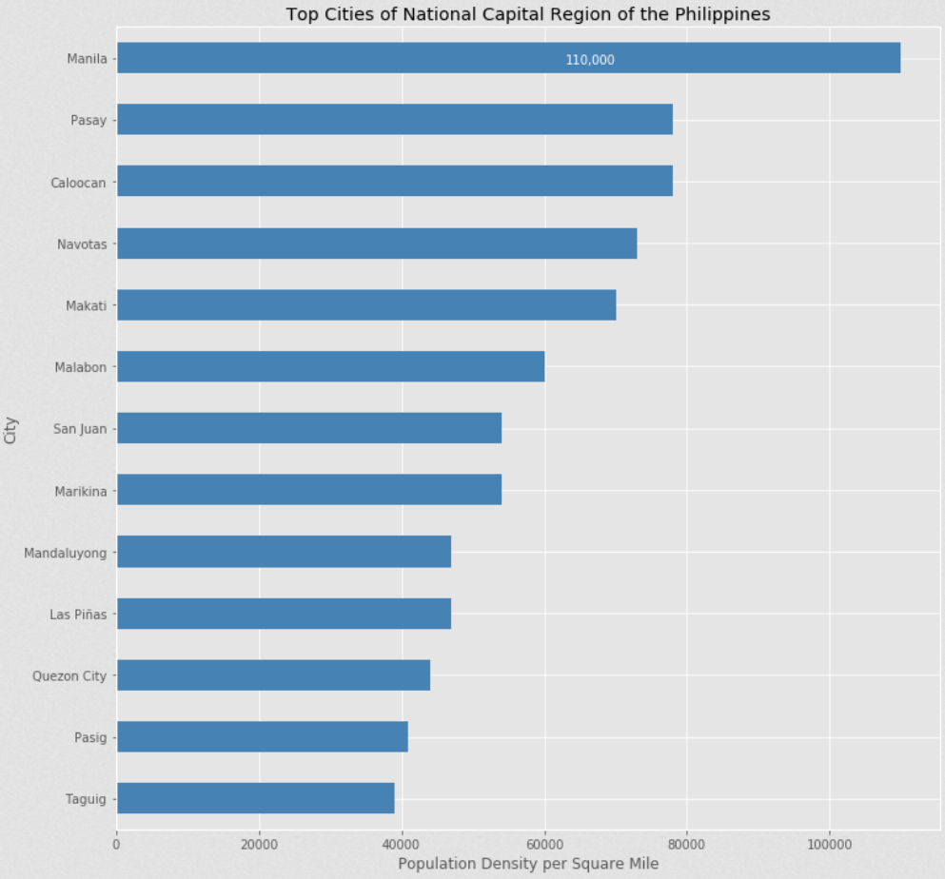
The top 5 cities are Manila (110,000), Pasay (78,000), Caloocan (78,000), Navotas (73,000) and Makati (70,000) in terms of Density per square mile.

Slide 13
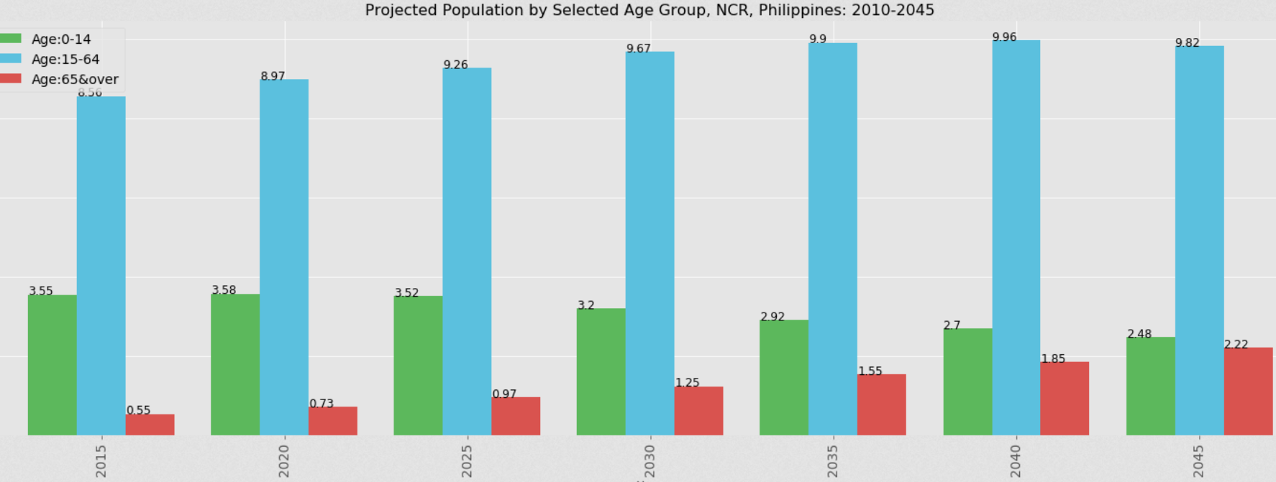
Projected Population
The projected population in Metro Manila is expected to increase by 630,000 or 5% from 2015 to 2020, and will continue to increase gradually every 5 years until 2045, particularly senior citizens.

Slide 14
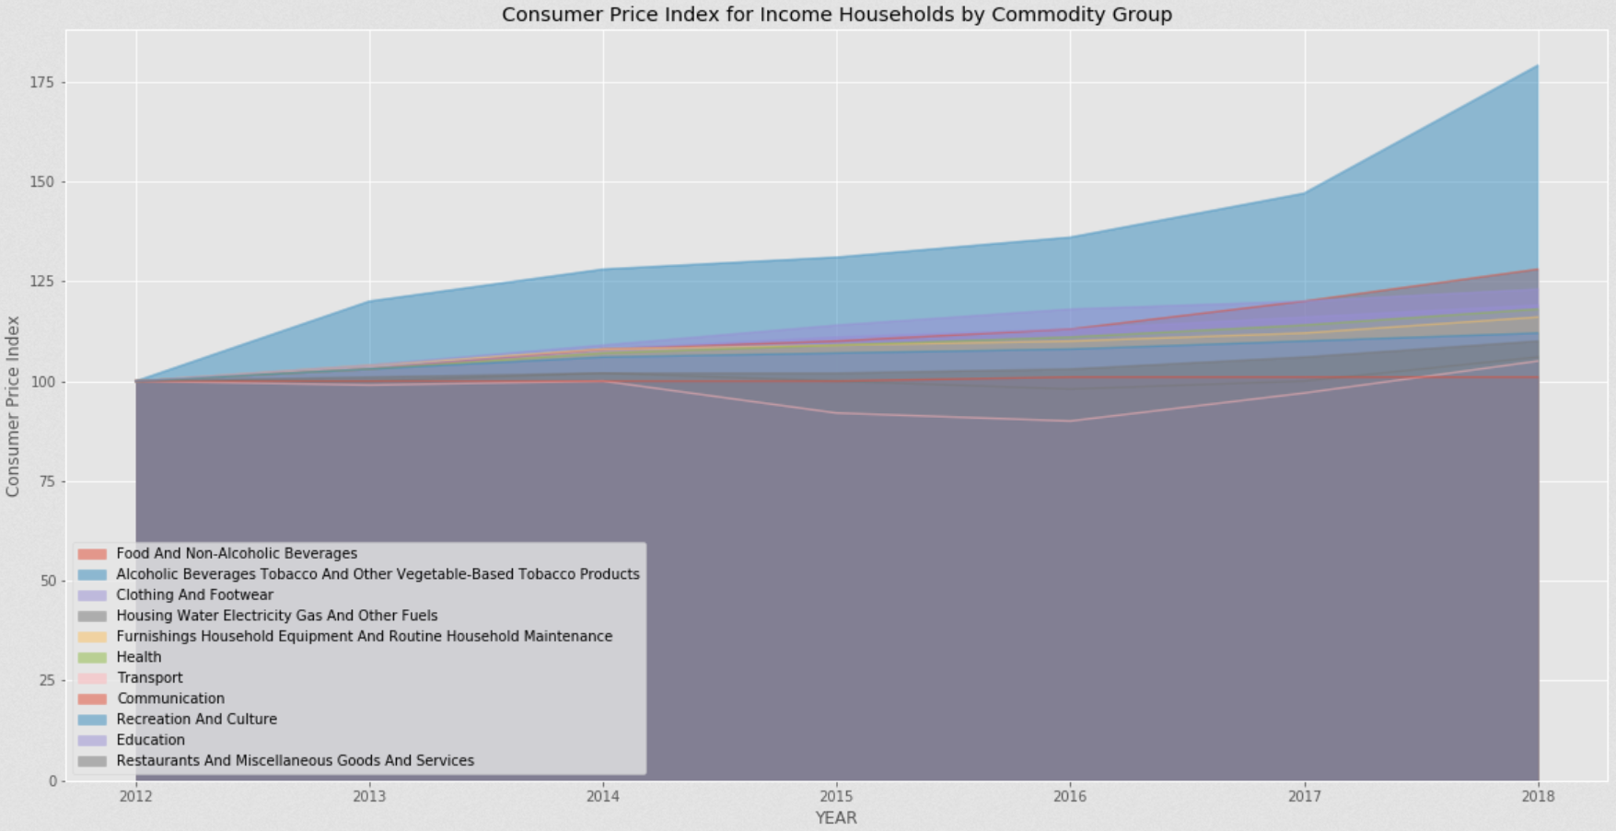
Consumer Price Index
The trend of Consumer Price Index from 2012 to 2018 for Metro Manila of all household goods and services including Foods are steady except for Alcoholic Beverages and Tobacco which incurred a 79% increase (100 to 179) due to sin taxes imposed by the government.
Accordingly, business operational costs such as food and beverage supplies, lease and rentals, electricity, water, gas, communication and transportation are expected to be stable as well in the future.

Slide 15
4. Results and Discussion
The best city
Based on the above exploratory data analysis and qualitative research about the cities mentioned, the City of Makati was selected due to the following:
It is one of the top 5 cities in Density per square mile (70,000 / sq mi) with a population of 582,602.
It is currently the top business district in the country with the highest concentration of multinational and local corporations.
Strategically located in the center of Metro Manila, as shown in the map below, it is surrounded by other cities such as Mandaluyong, Pasig, Taguig, Pasay and Manila.

Slide 16
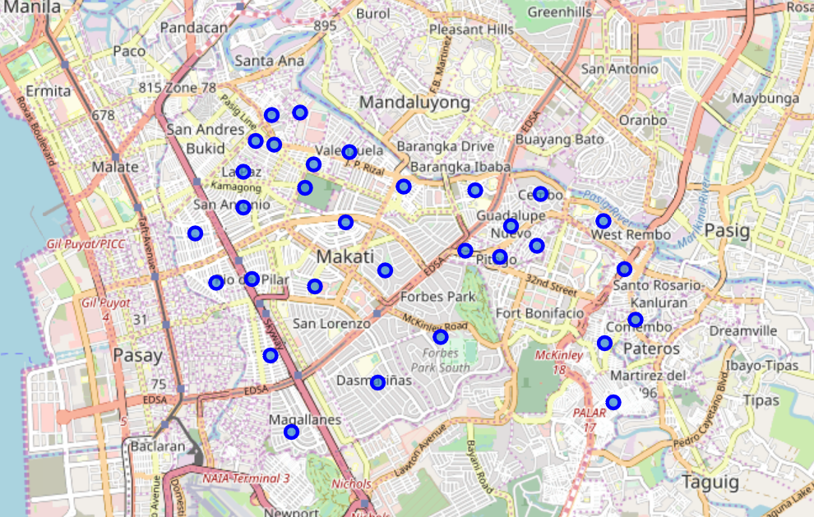
Makati neighborhoods
As per Wikipedia, there are 31 neighborhoods in Makati.

Slide 17
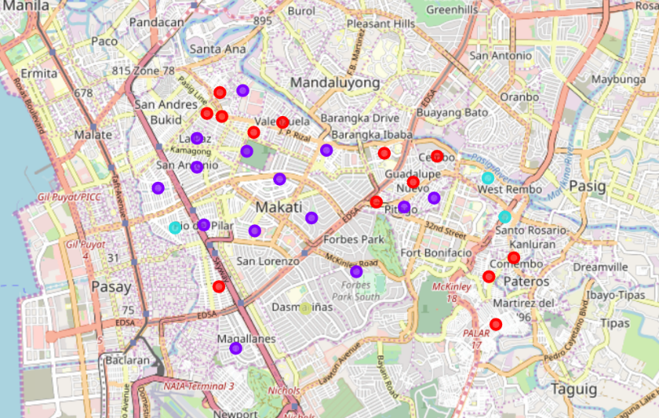
Makati neighborhoods
The neighborhoods were clustered using Kmeans as shown above.

Slide 18
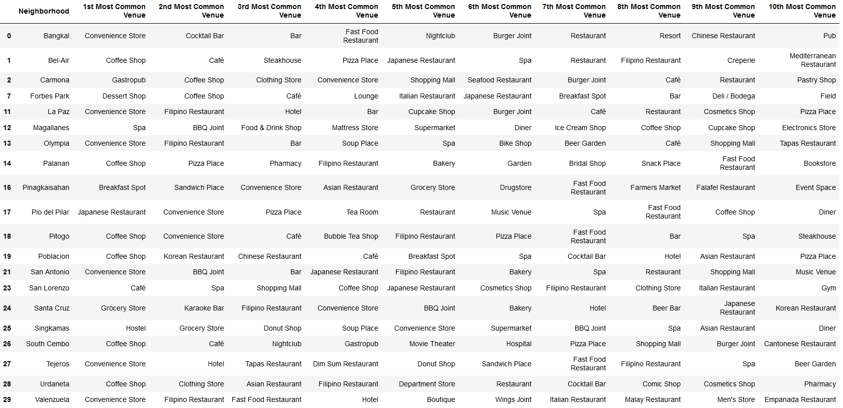
The winning cluster - 2

Slide 19
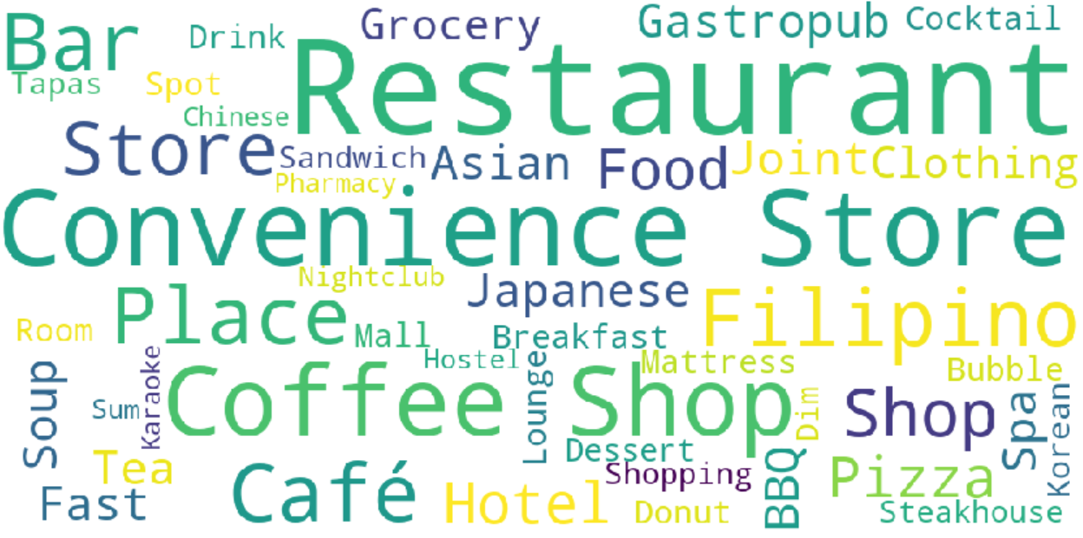
The winning cluster - 2

Slide 20
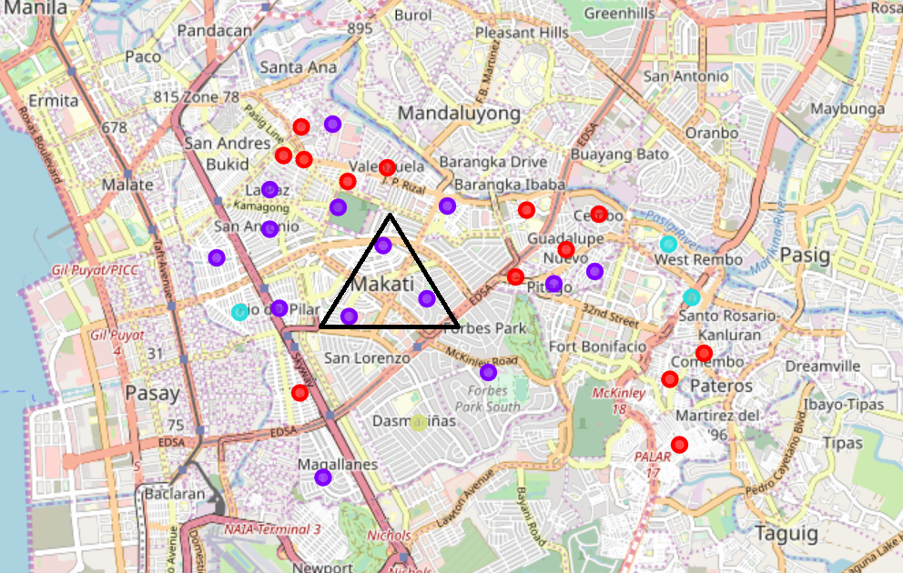
5. Conclusion
In conclusion, the neighborhoods of Cluster 2 is the ideal place to open the restaurant business in consideration of restaurants, groceries, malls and convenience stores being ubiquitous specifically around the area of the triangle which is the center of Cluster 2 drawn in the map above.

Slide 21
Thank you for your time.

